Slide 1
Organization Leadership
2024-2025

Slide 2
REPORTING OPTIONS
Required Reporting
Faculty
Staff (Advisors)
Dean of Students
Office of Compliance
University Police Department
Confidential Reporting
Counselors at SHW
Doctors/Nurses at SHW
Anonymous Reporting
EthicsPoint
https://secure.ethicspoint.com/domain/media/en/gui/19681/index.html
(Look for the link at the bottom of the TAMUK webpage)
*Kingsville Police Department are NOT required reporters. To notify the university of an incident please use a reporting option above.

Slide 3
Supportive Measures at Compliance
Mutual Orders of No Contact
Reporting to UPD
Counseling with Student Health and Wellness
Changes in On-campus Housing
Changes in Class Schedules
Changes in Work/Training/Practice Schedules
Communicating with Professors Regarding
Absences
Missed Course Work
Off Campus
Reporting to KPD
Transportation for SANE exam
Advocacy
Off-campus housing changes
Protective Orders
Legal Aid
Off-campus housing changes
Protective Orders
A formal complaint is not required to obtain supportive measures.

Slide 4
411 on Complaint Options
Compliance
Investigation Process
Informal Resolution
Safety Planning
Mutual Orders of No Contact
Assist with getting transportation for SANE
UPD/KPD
Criminal Process
Safety Planning
Protective Orders
Transportation to SANE
SANE exam
Driscoll Hospital
Doctor’s Regional
48 hours for suspected drugging
Up to 5 days to collect evidence
ASAP is best practice
Best to avoid showering, restroom, changing clothes
FREE
*You are not required to file a complaint with compliance or police to obtain a SANE exam

Slide 5
Title IX or Sex-based Misconduct Policy
Reports may fall under Title IX or Sex-based misconduct. Both policies have the same process and sanctions.
Sexual Assault
Oral Sex
Digital Penetration
Fondling
Ignoring boundaries
Sexual Exploitation
Lying about STI
Lying about condom use
Taking pictures/video without consent
Sharing pictures/video without consent
Sending images of private parts without consent
Sexual Harassment
Continual, unwanted words or conduct of a sexual nature or otherwise
Relationship Violence
Throwing things
Choking
Hitting/Slapping
Threats
Roommate Violence
Stalking
Following
Surveilling
Unwanted Gifts
Threats
Showing up at someone’s dorm, house, class, or work
Ignoring boundaries
Retaliation
Harassment toward someone who files a complaint
Treating someone different because they filed a complaint
*Off campus incidents can be reported.

Slide 6
Sanctions
If there is a finding of responsibility:
Sexual Assault
Suspension
Expulsion
Relationship Violence
Suspension
Expulsion
Sexual Exploitation
Probation
Suspension
Expulsion
Stalking based on sex
Warning
Probation
Suspension
Expulsion
Harassment
Warning
Probation
Suspension
Expulsion
Retaliation
Suspension
Expulsion
Depending on the allegation and sanction, students could lose eligibility for institutional scholarships and ability to participate in athletics/other organizations.

Slide 7
What does Consent sound look like?
Notes:
https://www.youtube.com/watch?v=raDPcy9tkLg

Slide 8
Notes:
https://www.youtube.com/watch?v=raDPcy9tkLg

Slide 9
Consent
CLEAR, WORDS, and ACTIONS that creates a MUTUAL AGREEMENT regarding the sexual activity that will take place.
Does NOT rely on:
Threats
Pressure
Coercion
The way someone is dressed
Flirtatious behavior
Prior encounters
Sexual History
Sexual Assault Myths:
Requires physical violence
Only committed by strangers
Only committed by men
Does not happen in LGBTQI+ relationships
*Look for an ENTHUSIASTIC partner.

Slide 10
What Consent Sounds Like
Starting the conversation…
What are you into?
I’m really enjoying our time together, do you mind if I…?
Do you want to…?
Raise your hand if you wanna go have sex!”
“Where do you want to be touched?”
“How can I make you feel good?”
“What do you want to do together tonight?”
“What words do you like to hear about yourself and your body?”
“What do you like in bed?”
Saying No to one thing…
Ooh that’s a three-month-in level thing for me…
I’m not really feeling that, but maybe we can do this?
Hang on, I want to take a break for a second.
I’m really not into that, but I do like…
That makes me uncomfortable, but what if we…
http://thesaltcollective.org/make-consent-sexy/

Slide 11
Scenario
A is in the locker room with B.
A asks B if they want to see something on their phone.
A shows B a naked picture of someone they went out with.
A mentions they took the picture during a sexual encounter.
B asks A for the picture and A share’s the picture.

Slide 12
Alcohol and Consent
Incapacity - A state in which a person, due to a disability, the use of alcohol or drugs, being asleep, or for any other reason, is not capable of making rational decisions about consent to sexual activity and recognizing the consequences of their decision.
Slurred Speech
Vomiting
Can’t walk without help
Odor of alcohol
Combativeness
Emotional Volatility
Confusion of basic facts (day of the week, etc.)
Passing out
Can’t focus on surroundings
*It DOES NOT matter who initiates sexual activity.

Slide 13
Drinking Facts
Other factors that you may not know:
History of Drinking
Weight
Age
Drinking on an Empty Stomach
Amount of Time the Drinks were Consumed

Slide 14
DRINKING FACTS
What is the number one drug found in incidents of sexual assault?
Alcohol
How many standard drinks in one red-solo cup of trash can punch?
On average 5
How long do you have to obtain a SANE exam if you think you’ve been drugged?
On average 48 hours

Slide 15
What does a healthy relationship look like?
Notes:
https://www.youtube.com/watch?v=raDPcy9tkLg

Slide 16
Relationships
Unhealthy
Healthy
Intensity
Possessiveness
Manipulation
Isolation
Sabotage
Belittling
Guilting
Volatility
Deflecting Responsibility
Betrayal
Comfortable Pace
Trust
Honesty
Independence
Respect
Equality
Kindness
Taking Responsibility
Healthy Conflict
Fun

Slide 17
Notes:
https://www.youtube.com/watch?v=4JYyHa03x-U

Slide 18
Safety Tips: Dating
Communication is key when setting up boundaries with partners. With online and in-person dating there are also additional safety tips that you can take:
Control information
Public Location
Transportation
Share location w/friends
Have a check-in
Pay attention to Red flags
Can communicate boundaries before and during the date

Slide 19
Scenario
A and B met during the first few weeks of school.
A asked B for B’s Instagram info.
B seemed to hesitate but sent it anyway.
After a couple of weeks, A asked B out and B said no.
A started sending DMs to B asking why they weren’t interested. B asked A to stop contacting them.
A doesn’t stop.
B blocked A, so A decided to drive around B’s apartment and find them on campus.
B started receiving gifts at their work.

Slide 20
Safety Planning
During a break-up there can be safety issues if the relationship was unhealthy. Safety planning may involve:
Have a phone charged
Create code words
Unpair communication
Protective Orders/NCOs
Walk with a group
Change routine
Think about exit routes
Online presence
Location drop-offs
Advocacy/Legal Aid

Slide 21
Bystander Intervention
Options to intervene:
Direct – speak to the event taking place and the likely outcome
Delegate – seek help from friends and/or authority figures to help you intervene
Distract – Interrupt the situation with a distraction that doesn’t bring attention to the situation
May be used to split-up two people

Slide 22
Creating a Culture of Resect
Discuss behavioral expectations for group members
Model behavioral expectations for group members
Reinforce behavioral expectations for group members
May use bystander intervention
Report concerning behaviors

Slide 23
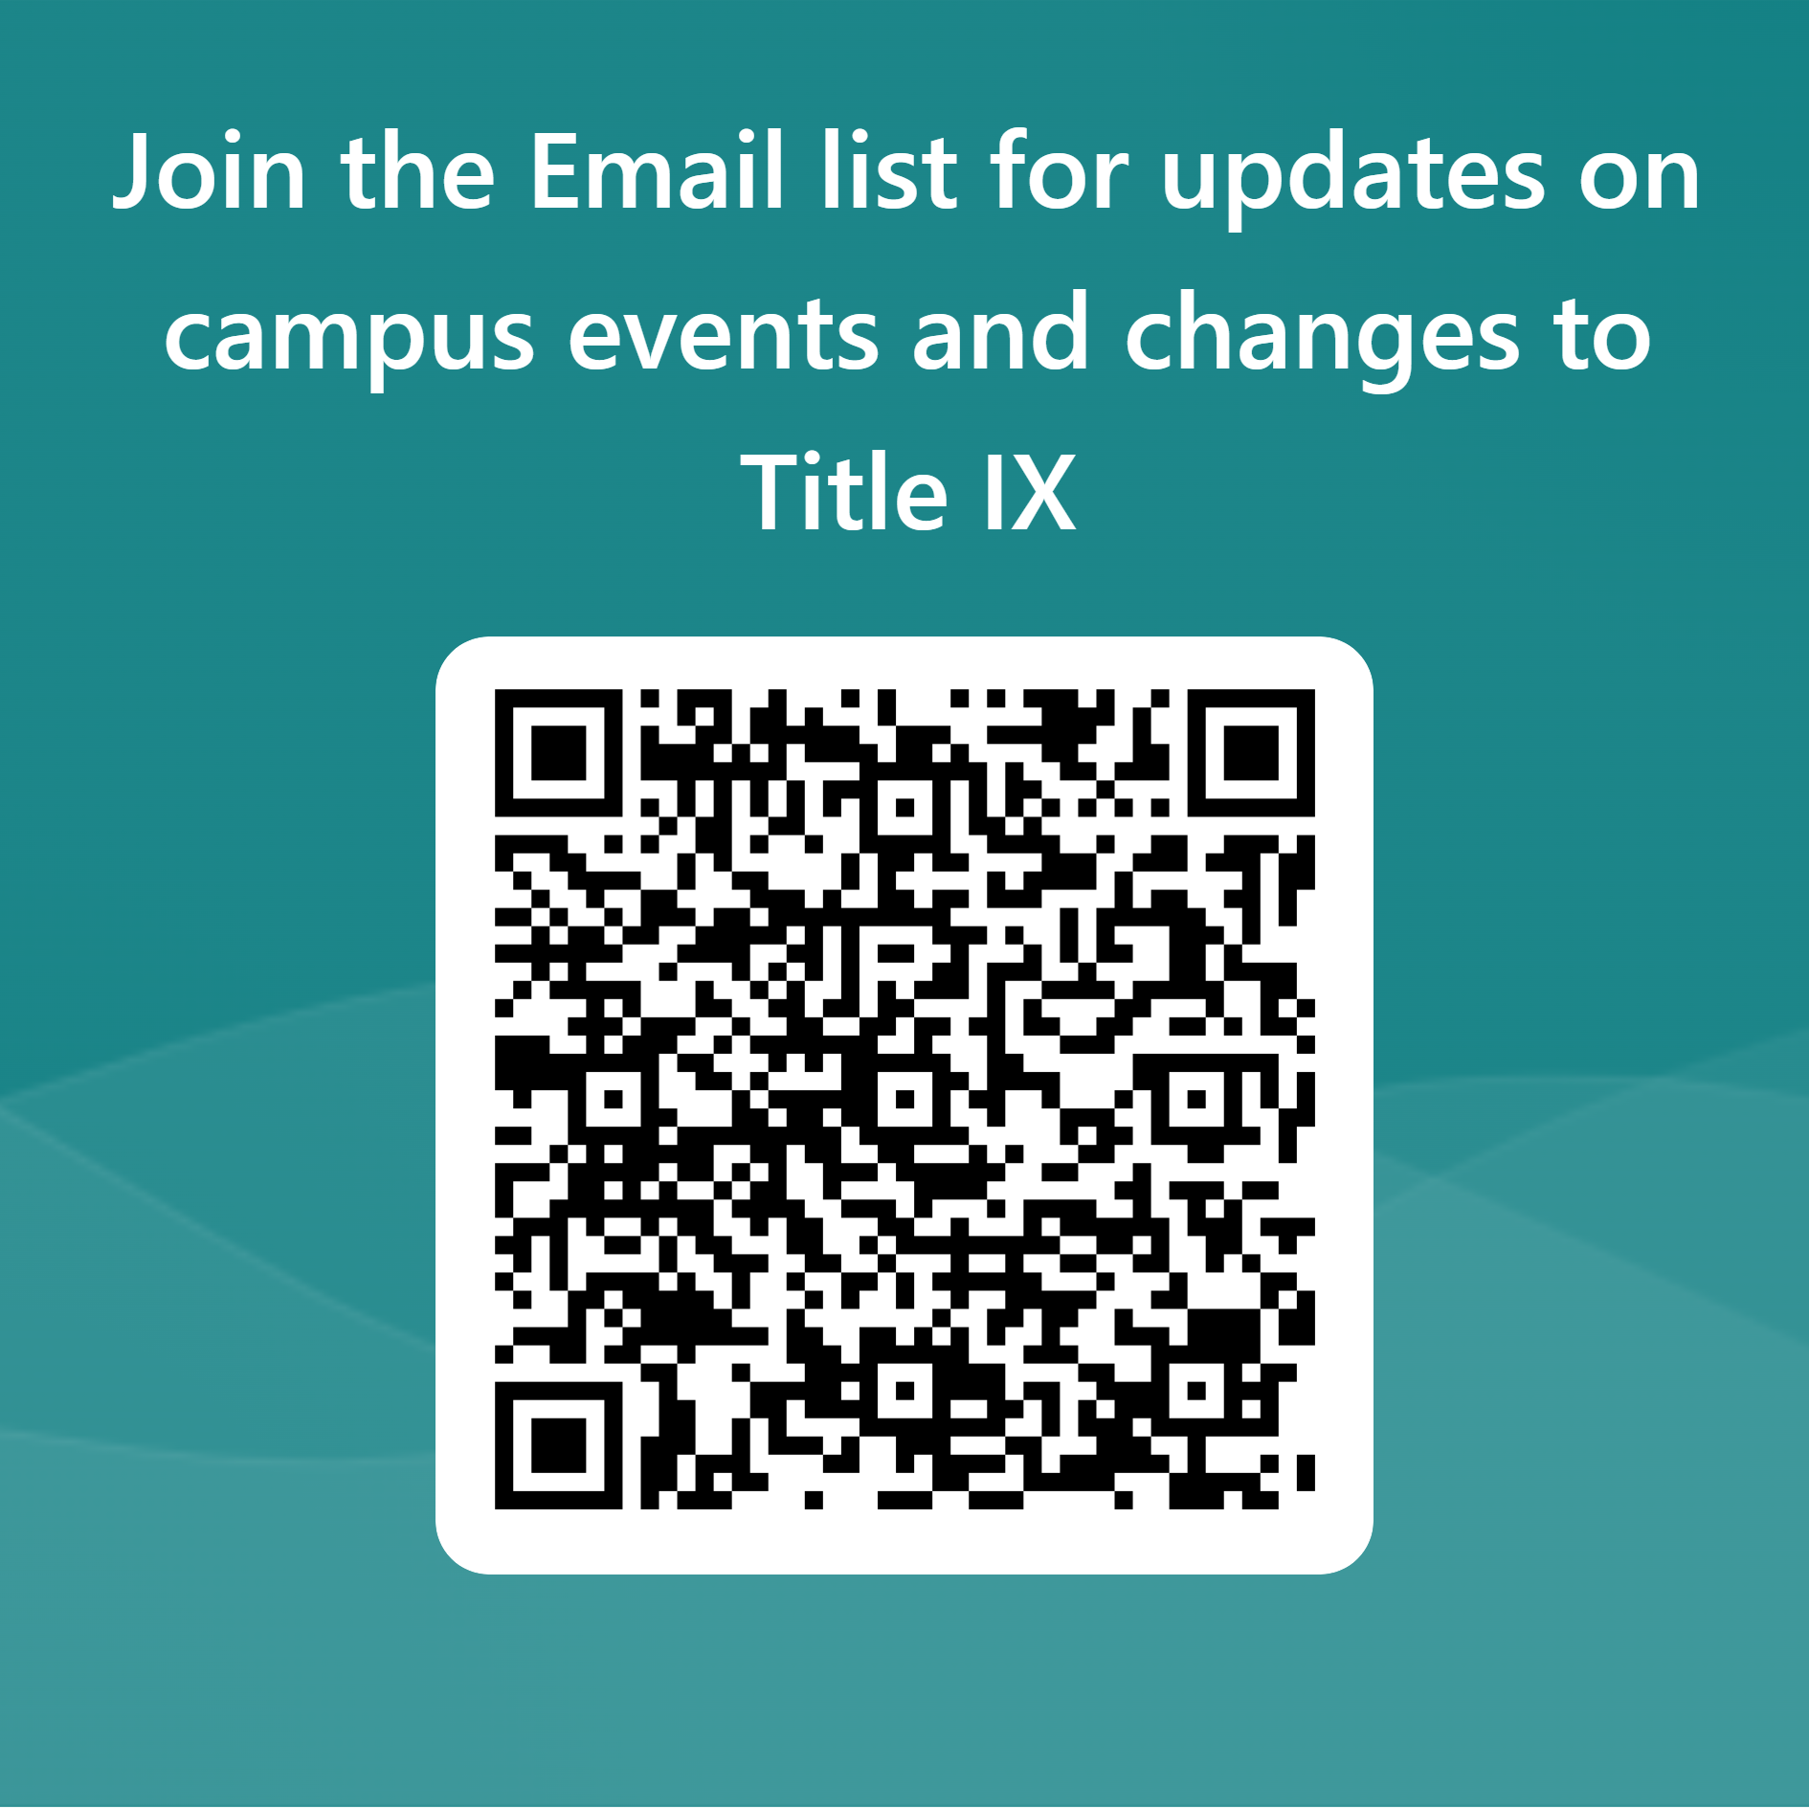
Questions
Office of Compliance
Lewis Hall, Suite 130
361-593-4758

