Slide 1
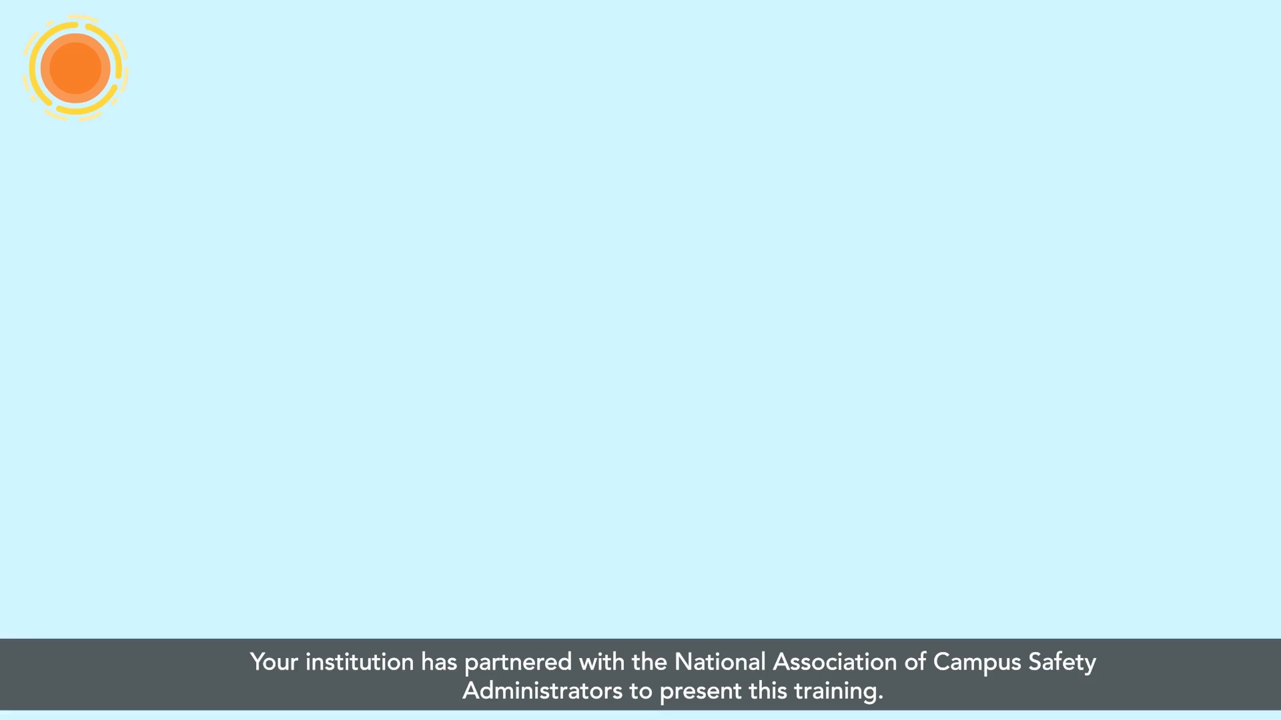

Slide 2
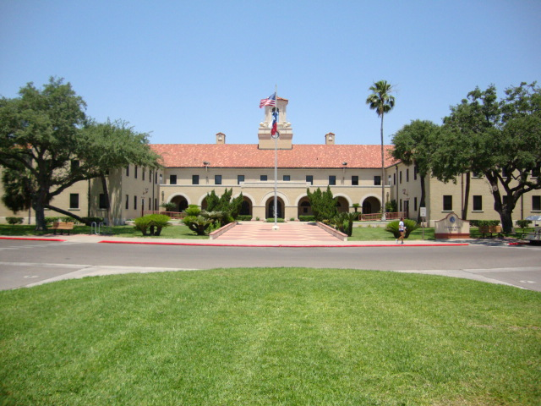
CAMPUS CLERY COMPLIANCE COMMITTEE
CSA TRAINING - 2022

Slide 4
Topics
What is the Clery Act?
Who is a Campus Security Authority (CSA)
Responsibilities of a CSA
Crime Incident Classification
------------
What you need to know if you are a Campus Security Authority at Texas A&M University - Kingsville

Slide 5
What is the Jeanne Clery Act?
In essence a Consumer Protection Law
Student Jeanne Clery was raped and murdered in her dorm room at Lehigh University in 1986.
Parents felt that had they known more about crime in the area, they might have made different decisions. Lobbied Congress to pass the law.
The Jeanne Clery Disclosure of Campus Security Policy and Campus Crime Statistics Act of 1990, requires colleges to publicize their campus crime statistics and security measures they have in place. Subsequent laws have established other reporting requirements. (Title IX; VAWA)

Slide 6
Clery Act Requirements
Universities must:
Disclose, collect, classify and count crime reports and statistics
Issue Crime Alerts - timely warning for any Clery Act-specified crime that represents an ongoing threat to the safety of students or employees
Issue Emergency Notifications upon confirmation of significant emergency or dangerous situation involving immediate threat to health or safety
Publish Annual Security Report with specific policy statements
Submit Crime Statistics to Department of Education
Maintain a publicly available daily crime log
Implement missing student notification procedures
Maintain Fire Safety information - including fire log, annual fire report with statistics and policy statements
Disseminate information about report to students, faculty, and staff (current and prospective)

Slide 7
Clery Act Requirements, continued
Universities must publish campus crime statistics for the previous 3 years
The Annual Security Report (ASR) also includes referral information to ensure that students and others know about crime reporting procedures and available resources.
Information must be made available to current and prospective students and employees by October 1
Data is collected from a wide variety of “Campus Security Authorities”–That’s where you come in.
$59,017 per violation, per day

Slide 8
CSAs at TAMUK
Includes but is not limited to:
  Acting Director for Student Affairs
  Asst. VP / Dean of Students; Assoc. Dean of Students
  Executive Director of Athletics & Campus Recreation; team coaches (Men’s -football, basketball, baseball, cross-country, track and field; Women’s – basketball, cross-country, golf, softball, tennis, track and field and volleyball, cheer teams;
  Sr. Assoc. Athletic Director/Head Athletic Trainer and assistant trainers;
  Executive Director of International Studies and Programs;
  Director of International Studies & Program
  Director of Student Health and Wellness (SHW) Department, Medical Providers in SHW; Staff nurses; Coordinator of Disability Resources;
  Director of Student Activities

Slide 9
TAMUK CSAs - continued
Includes but is not limited to:
  Executive Director, Director of Housing, Associate Director of Residential Education, Assistant Director of Residence Life, and Area Coordinators, Head Residents and Resident Advisors, for University Housing and Residence Life;
  Faculty / staff Advisors for Texas A&M University-Kingsville student organizations;
  Professor and instructors of Military Science;
  Compliance Officer;
  Title IX Coordinator; and,
  Faculty/staff advisors to other student groups.

Slide 10
Who Is NOT a CSA?
Administrative and clerical staff not responsible for students (e.g., payroll, administrative assistants, receptionists, etc.).
Facilities staff such as custodians, plumbers, electricians, etc.
Other support staff (food service workers, cashiers)
Faculty who do NOT serve as an advisor to a registered student organization; no responsibility for student or campus activities beyond the classroom.

Slide 11
Reporting Crimes on Campus
Texas A&M University‐Kingsville and the University Police Department (UPD) encourage the prompt reporting of any incident that compromises the safety, health or rights of university community members to the University Police Department.
Call UPD directly (361)593-2611,
Report online
http://www.tamuk.edu/upd/crime-report.html
JavGuard app

Slide 12
CSA Responsibilities
The Campus Security Authority’s primary responsibility is...
“to report allegations made in good faith to the reporting structure established by the institution.”
In “good faith” means there is a reasonable basis for believing that the information is not simply rumor or hearsay. That is, there is little or no reason to doubt the validity of the information. What you must disclose, therefore, are statistics from reports of alleged criminal incidents.
It is not necessary for the crime to have been investigated by the police or a campus security authority, nor must a finding of guilt or responsibility be made to disclose the statistic.
CSA’s must be trained to immediately report crimes to the institution’s reporting structure, so these reports may be assessed for potential Timely Warning Notices if necessary. The university does not want a CSA to receive a report of a crime and then wait a few days to submit the information. The institution has lost the opportunity to react in a timely manner to the reported crime and respond accordingly.

Slide 13
Reporting An Incident – Get the Facts
Important questions to ask
Is a violent crime in progress? (Call police)
Has the victim sought or is in need of assistance services?
What happened? How, when and where did it happen? Is there an identified suspect?
Has incident been reported to police or other CSA?
Does victim wish to remain anonymous?

Slide 14
Crimes We Must Report:
Murder/Non-Negligent Manslaughter
Manslaughter by Negligence
Sex Offenses - forcible (Rape, Fondling) & non-forcible (Incest, Statutory Rape)
Aggravated Assault
Robbery
Burglary
Motor vehicle theft (includes golf carts)
Arson

Slide 15
Crimes We Must Report – cont.
Domestic Violence
Dating Violence
Stalking
Hate Crimes (categories of bias include the victim's actual or perceived race, religion, gender, gender identity, sexual orientation, ethnicity, national origin, and disability)
Weapons Violations
Drug Abuse Violations
Liquor Law Violations

Slide 16
Other Violations That Must Be Reported:
Hate crimes, including the seven prior listed on prior page, or any other crime causing bodily injury, if motivated by hate. The current regulations added the crimes of larceny-theft, simple assault, intimidation, and the destruction, damage, or vandalism of property to the list of hate or bias-related crimes.
Any liquor, drug or weapons violations-both arrests and disciplinary referrals for students and employees (staff & faculty) and arrests of campus visitors.

Slide 17
Timing is Critical
Be sure to document…(use the form provided)
  When the crime or incident occurred
  When it was reported to you
The law requires that the crime be included in the Clery Crime Report for the calendar year in which it was first reported to a Campus Security Authority.
May need to issue a Timely Warning Notice

Slide 18
Report Crimes by Location
Campus Geography
A crime must be reported if it occurred
On-campus or on TAMUK property.
On-campus in university residence halls.
On public property adjacent to campus (streets, sidewalks, parking lots, parks)

Slide 19
Report Crimes by Location, cont.
Under the law, some off-campus locations are deemed so closely related to the University that crimes occurring at those locations are included in campus crime statistics.
Example: Crimes occurring at student organization properties and at university owned or controlled facilities “frequently used by students.”

Slide 20
Off-Campus Locations
These off-campus properties are termed “non-campus property,” defined by law to include:
Property owned or controlled by TAMUK (e.g. natural reserves (Site 55), University Center building in Harlingen, Weslaco Center.
Property owned or controlled by a student organization registered with campus (e.g. a fraternity).

Slide 21
The Clery Report Does Not Include Crimes Unrelated to TAMUK
For Example,
A student tells you about a crime that occurred at a different college before he transferred here.
A student reports an assault that happened away from campus and did not involve a campus activity e.g., home for spring break, in an off-campus student apartment, on vacation or at an off-campus job with a private company.

Slide 22
Explain Reporting Options
Let the person know about options for reporting to police. Inform him/her about confidential reporting process available through TAMUK Police.
Please remember a person does not have to talk to police, but any information reported to you, needs to be reported to police.

Slide 23
Important Information
TAMUK Police Department 361-593-2611
Clery report website – https://www.tamuk.edu/dean/dean_files/cleryreport.pdf
CSA Crime Report submission online: http://www.tamuk.edu/upd/crime-report.html
Questions?
Contact TAMUK Chief of Police, Felipe Garza,
361-593-2639
Contact TAMUK A/Lieutenant Gabriel Gonzalez, 361-593-2641
CLERY STATISTICS DEADLINE: December 31, 2022

Slide 24
    TEXAS A&M UNIVERSITY-KINGSVILLE
UNIVERSITY POLICE DEPARTMENT CAMPUS SECURITY AUTHORITY (CSA) 2021
    CRIME STATISTIC REPORT FORM
Please forward this completed form to: Felipe Garza, Director of Public Safety/Chief of Police, MSC 126, felipe.garza@tamuk.edu
According to the Jeanne Clery Disclosure of Campus Security Policy and Campus Crime Statistics Act (20 U.S.C. § 1092(f)), Texas A&M University-Kingsville is required to collect and annually publish statistics concerning the occurrence of selected crimes on campus property (including residential facilities), non-campus property, and public property, reported or known to University Police, local police or any individuals identified by the University as "Campus Security Authorities” (CSA). Campus Security Authorities are defined as,
“An official of an institution who has significant responsibility for student and campus activities, including but not limited to, student housing, student discipline, and campus judicial procedures.” The information collected from these forms is used to prepare a compilation of statistical crime information for inclusion in the campus' Annual Security Report. University Police will use this form to determine the category of the crime or incident and the location under which the incident should be reported according to the requirements of the Clery Act. Data collected on this form is to be used to promote crime awareness and enhance campus safety.
Texas A&M University-Kingsville strives to ensure that complainant and witnesses to crime are aware of their right to report criminal acts to the police, and to report University policy violations to the appropriate office. However, if a reporting person requests anonymity, this request must be honored to the extent permitted by law. Accordingly, no information should be included on this form that would personally identify the complainant without his/her consent.
For Clery purposes, the student status of the complainant or the respondent is not a relevant fact as to whether or not this report form is to be completed. If a violation of one of the 21 listed offenses occurs on Texas A&M University-Kingsville Clery geography, documentation is required, regardless of whether it is believed another report had been previously filed. In order for the university to satisfy the statistical reporting requirements of the Clery Act, all CSAs are required to complete this form or on-line on the UPD website using the Report a Crime link (https://www.tamuk.edu/dean/dean_files/cleryreport.pdf) when specified crimes/incidents (listed below) are reported to them or at the end of the year advising no crimes were reported to them. In addition, a person reporting an incident to a CSA shall also be encouraged to report the crime to the Texas A&M University-Kingsville Police Department and/or Director of Compliance or Title IX Coordinator offices.
Procedures If you are one of university’s CSAs and you receive a report, or otherwise become aware of the occurrence of one of the selected crimes listed below, please do the following:
“Good-faith” confidential, second hand or anonymous reports shall be accepted.
Encourage the crime complainant (s) and/or witness(es) to report the incident to University Police (361-593-2611)
If the incident indicates the possibility of an imminent community threat, inform UPD without delay.
If the incident reported is a sexual assault or other violent crime:
      Inform the complainant (s) and/or witness(es) of the support services available
        Actively support the complainant (s) and/or witness(es) in accessing these services.
Complete the Crime & Incident Report form and handle as a “confidential” document.
Submit the form (pages 1-2) in a confidential envelope and deliver it to: UPD 855 N. University Boulevard (Lewis Hall), MSC126 Kingsville, Texas 78363
      If no crimes were reported to you in 2021, please check the box below, print your name and initial. This form is being used to document that you have received this reporting form and that no crimes were reported to you for the previous reporting cycle.
        Reporting Person (CSA)(print name): Department: Position: Phone Number: Date:
              By placing an X on this line, you are confirming that no crimes, as described below, were reported to you during the r year, 2021. Signature here:

Slide 25
TRAINTRAQ Course
2111844 : Clery Act Guidelines for A&M System Campus Security Authorities

