Slide 1
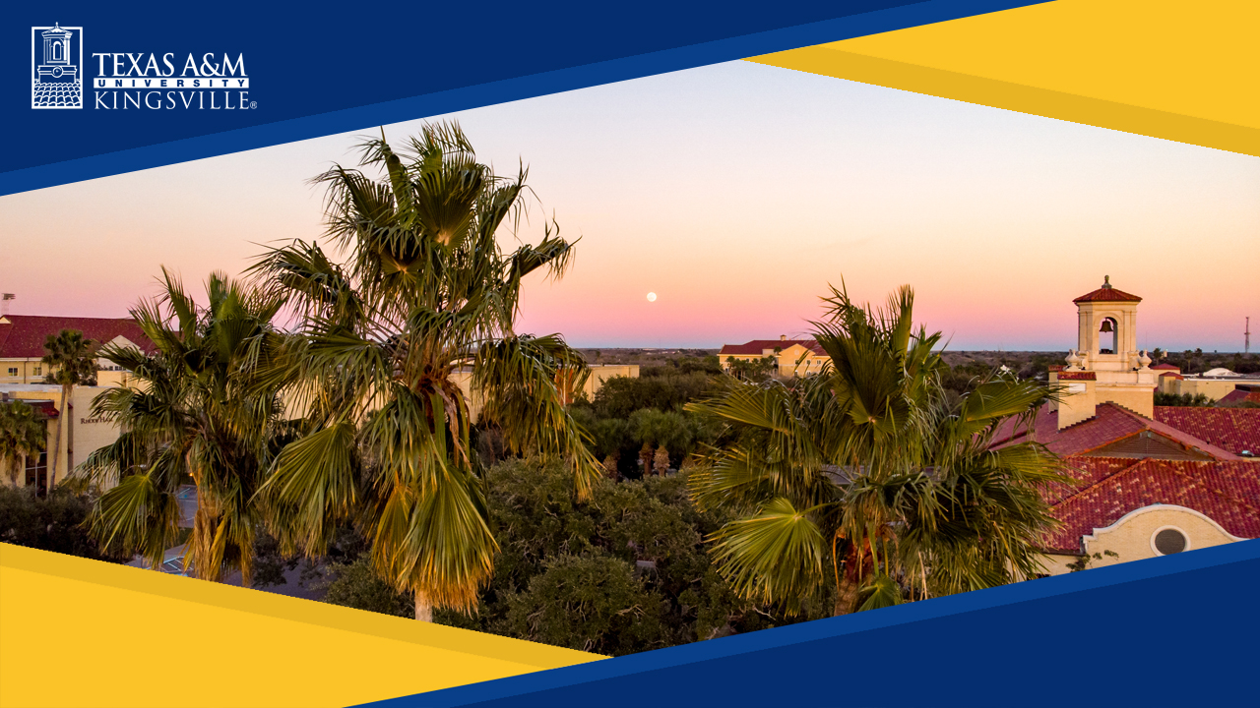
Mentoring Undergraduate and Graduate Students in Research
Matthew Alexander
Dept. of Chemical & Natural Gas Engineering
Texas A&M University-Kingsville, Texas

Slide 2
My student research mentoring at TAMUK
Undergraduate: ~ 15 undergrad in various TAMUK-sponsored programs, ~10 undergrad in NSF CREST grant;
MS graduates: 40 total, 20 MS thesis and 20 MS project;
1 PhD graduate
Developed and taught PhD-level course on research methods for new PhD in Engineering program

Slide 3
Student Research Opportunities (High Impact Practice)
Undergrad & Grad
Research Opportunities
Methods for
Student Mentoring
Outcomes

Slide 4
Research Opportunities for Undergrads
McNair Scholars Program (Dept of Ed grant);
Centers for Research Excellence in Science and Technology (CREST) NSF grant;
Greater Texas Foundation (GTF) grants;
Presidential Undergraduate Research Scholars(PURS) program--occasional;
TAMUK Council for Undergraduate Research (TCUR)—occasional;
Research Experience for Undergraduates (REU) NSF grant.
All of these programs require the student to seek out a faculty mentor, and for the faculty and student to mutually agree upon a research topic.

Slide 5
Undergraduate Research Opportunities at TAMUK
Research Program | Program Characteristics
McNair | Structured program for summer research with stipend support, including prep for graduate school, and conference opportunities
CREST | Year-round stipend support for research on sustainable water use, including conference opportunities
GTF | Honors College funding source for fall or spring student research, includes conference opportunities, minimal structure
PURS | University source for fall or spring research, minimal structure
TCUR | University source for fall or spring research, minimal structure

Slide 6
Research Opportunities for Grads
(prefer research funding support, but not an absolute)
Federal or state grant with stipend support directly on research topic;
Funded project report providing stipend / wage to student for financial support, but not necessarily on research topic;
TA support to student, not related to research;
No financial support to student.

Slide 7
How Undergrad & Grad Research Provides Opportunities for Student Development
Independent work: progress on the research topic is entirely up to the student, and no one else;
Communication skills: listening and conversing with mentor are skills critically important to student’s research; oral and written communication of research plans and results is critical to dissemination of the findings;
Technical skill development: learning based on support from advisor, but also learn on their own (beyond advisor’s knowledge base).

Slide 8
Methods for Student Mentoring
Undergrad & Grad
Research Opportunities
Methods for
Student Mentoring
Outcomes

Slide 9
Undergrad & Grad Research Mentoring Approach
Explain the independent nature of UG research;
Set regular faculty-student meeting times;
Set expectations for research progress each week, and for longer-term (semester), take into consideration student’s other workload(s);
Explain the try-fail-retry nature of experimental chemical research;
Be accommodating towards prior experience or lack thereof;
Take into account student’s aptitude (learns fast, or requires remedial efforts?) and personal confidence level

Slide 10
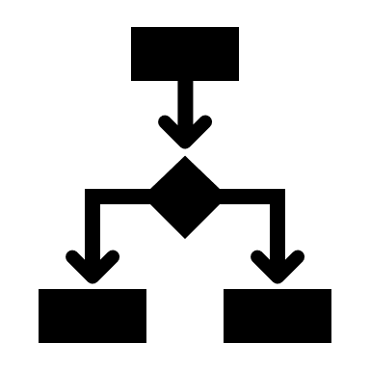
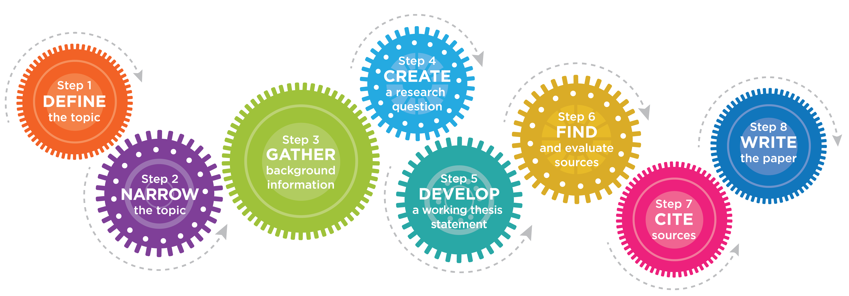
Undergrad & Grad Mentoring
Research Steps
Define the research topic;
Understand literature in the field (literature search);
Develop research question;
Introduce student to lab or computer model methods;
Conduct lab / computer work;
Analyze data, prepare final research report and presentation.

Slide 11
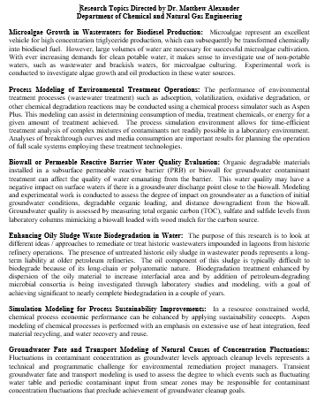
Define the research topic---let student have significant input / choice in research topic, which will keep their interest

Slide 12
My Personal Comments
I’ve seen very wide range of UG and GS capabilities
Sophomores with research understanding at MS level
MS thesis students with capability at junior undergrad level
Because research mentoring is 1-on-1 relationship, each person has different needs and different levels of input required of me
Begin by treating all students with respect; do not treat a research student as a commodity to produce expected results in x time.

Slide 13
Outcomes
Undergrad & Grad Research Opportunities
Methods for Student Mentoring
Outcomes

Slide 14
Specific Student Outcomes--Undergrad
Prior to graduation
McNair and CREST students have won 1st and 3rd place awards at TAMU Pathways, TAMUK Javelina Research Symposium, University Council on Water Resources conference, and the Annual Biomedical Research Conference for Minoritized Scientists
Two students had their UG research papers published in the TAMUK Javelina Undergraduate Research Journal;
Post graduation
Several UG research students have gone on to grad school at Tier 1 universities;
Former undergraduates
awarded a Fulbright Fellowship
Awarded NSF Graduate Research Fellowship
Accepted to CMU 5-yr program PhD in Engineering and International Studies

Slide 15
Specific Student Outcomes--Grad
Prior to graduation
Students have won 3rd place awards at TAMU Pathways,
Multiple students have had articles published in peer-reviewed journals
Post graduation
Several UG research students have gone on to grad school at Tier 1 universities;

Slide 16
Specific Student
Outcomes: Failures and Challenges
Not all advisor-mentor relationships have positive endings (my personal experiences)
Students dismissed by me from advisor-advisee relationship due to major plagiarism violations
Students not completing MS thesis prior to leaving for next grad school opportunity
Student frustration and desire to quit after not passing thesis proposal or thesis defense
Lack of commitment to research effort by undergraduate student
3 ½ years to complete MS thesis
My approach to salvage bad situations
Treat students with respect
Be patient in directing them to recover or fix it and make amends

Slide 17
Conclusions
Effective mentoring of student researchers results in
Independence, self-reliance;
Higher technical skills;
Communication skills, especially at higher technical / professional levels;
Self-efficacy, self-confidence.

Slide 18
Mentoring Undergrad & Grad Research
DISCUSSION
What do you personally feel are critical elements or aspects to student research success, that you can impact thru your mentoring?
What is a good way to deal with students that struggle with the independent nature of research work (that need lots of “hand-holding”)?
What would you try in the case of impending failure of a research student?

