Slide 1
PRELIMINARY FIXED ASSETS
DEPARTMENT PROCEDURES

Slide 2
INTRODUCTION

Slide 3
All pertinent information
related to the asset
Notes:
Purchase Order number, description of the item, department in charge of item, model number, serial number, the location of the item, the person using the item, and so forth.

Slide 4
All capital and controlled
assets must be entered
Notes:
Items over $5000 and certain items between $500 and $5000 (firearms, computers, printers, TVs, VCRs, Camcorders, Cameras, Stereo Systems and Projectors—digital only, not mounted)

Slide 5
Must enter preliminary fixed
assets before receiving may
be closed
Notes:
Must be entered for all items classified as capitalized or controlled before receiving may be closed

Slide 6
Preliminary Fixed Assets
Menu

Slide 7
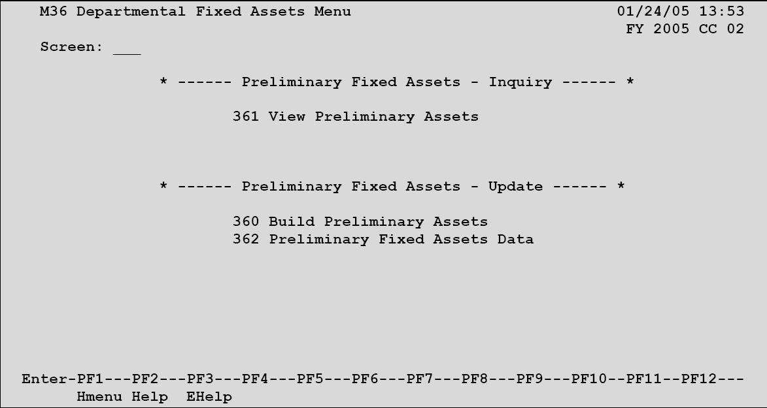
M36 - Departmental Fixed Assets Menu
Notes:
Only three primary screens will be used

Slide 8
Preliminary Fixed Assets
Inquiry And Update

Slide 9
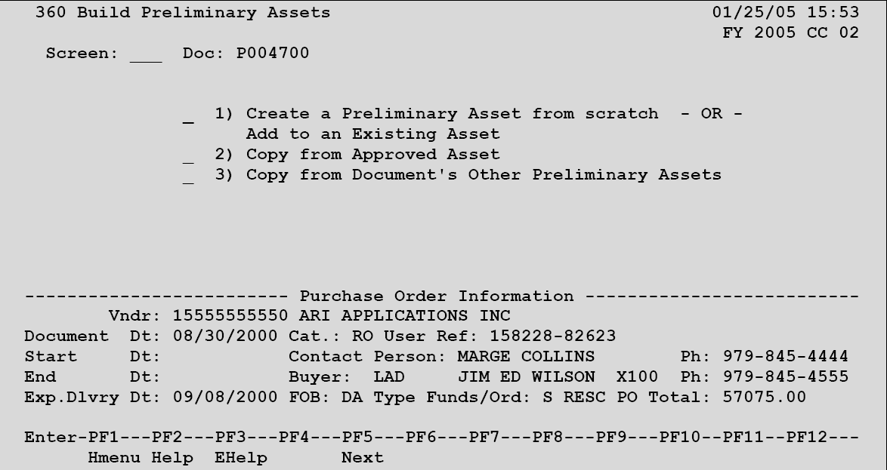
Screen 360 – Build Preliminary Assets
Notes:
Put in a valid PO number and select option 1

Slide 10
CREATE A
PRELIMINARY ASSET
FROM SCRATCH

Slide 11
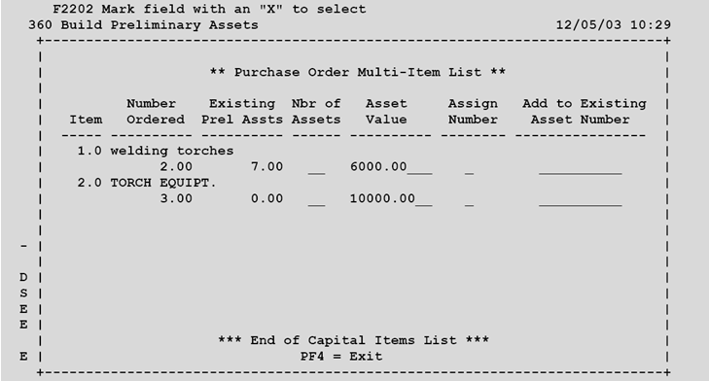
Screen 360 – Build Preliminary Assets
Purchase Order Multi-Item List
Notes:
Pop-up screen for option l; type number of assets and Y to assign number; press enter

Slide 12
PRELIMINARY ASSETS
AND
INVOICE MATCHING
Notes:
Creation of assets must be for the whole dollar amount on the document

Slide 13
Changing the asset value
Partial Shipments
Partial Payments
Notes:
Include freight charges, if known; back out items not received and reset to ‘preliminary’ status; blank out asset field for any assets not actually paid and create a PA again on the next invoice

Slide 14
COPY FROM
APPROVED ASSET
Notes:
Use this option for an asset record identical to a previous item

Slide 15
Screen 360 – Build Preliminary Assets
Copy From Approved Asset
Notes:
Select option 2—no document number is required

Slide 16
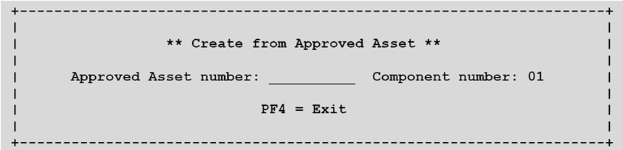
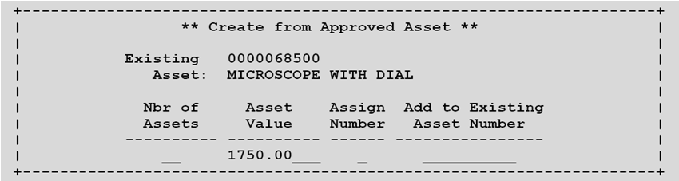
Screen 360 – Copy from Approved Asset Pop-Up Window #1
Screen 360 – Copy from Approved Asset Pop-Up Window #2
Notes:
Put asset number you want to copy on pop-up window 1; on pop-up window 2 type the number of assets to be created and Y in the assign number field; update information for each copied asset on Screen 362

Slide 17
COPY FROM DOCUMENT’S
OTHER PRELIMINARY ASSETS
Notes:
Use this for a PO with several identical items

Slide 18
Screen 360 – Build Preliminary Assets
Copy from Document’s Other Preliminary Assets
Notes:
Use Create PA from Scratch to build PA records on the PO; then, go to Screen 360 again and choose option 3

Slide 19
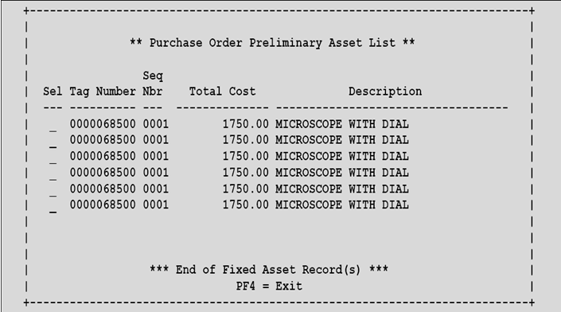
Screen 360 – Copy from Document’s Other Preliminary Assets Pop-Up Window #1
Notes:
On pop-up window 1, type X to select a tag number and you will advance to pop-up window 2

Slide 20
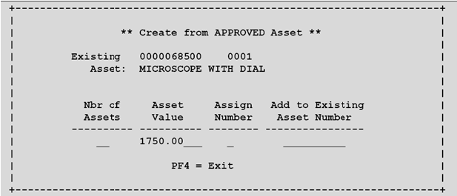
Screen 360 – Copy from Document’s Other Preliminary Assets Pop-Up Window #2
Notes:
Type number of assets to be created; type y in assign number field; press enter; update information of Screen 362 for copied assets

Slide 21
VIEW PRELIMINARY
FIXED ASSETS
Notes:
Screen 361

Slide 22
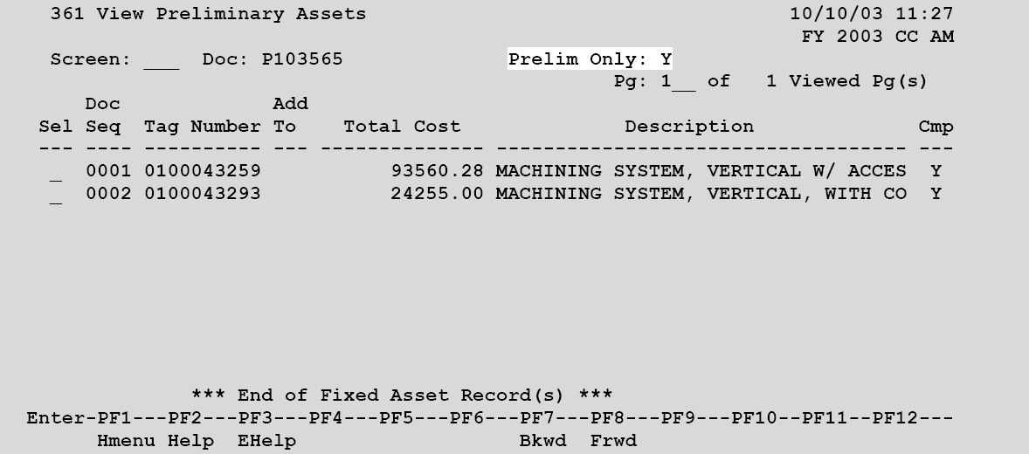
Screen 361 – View Preliminary Assets
Notes:
Type valid PO number and press enter to display records; place X in select field to advance to Screen 362

Slide 23
MODIFY PRELIMINARY
FIXED ASSETS
Notes:
Screen 362 used to add required information for asset approval

Slide 24
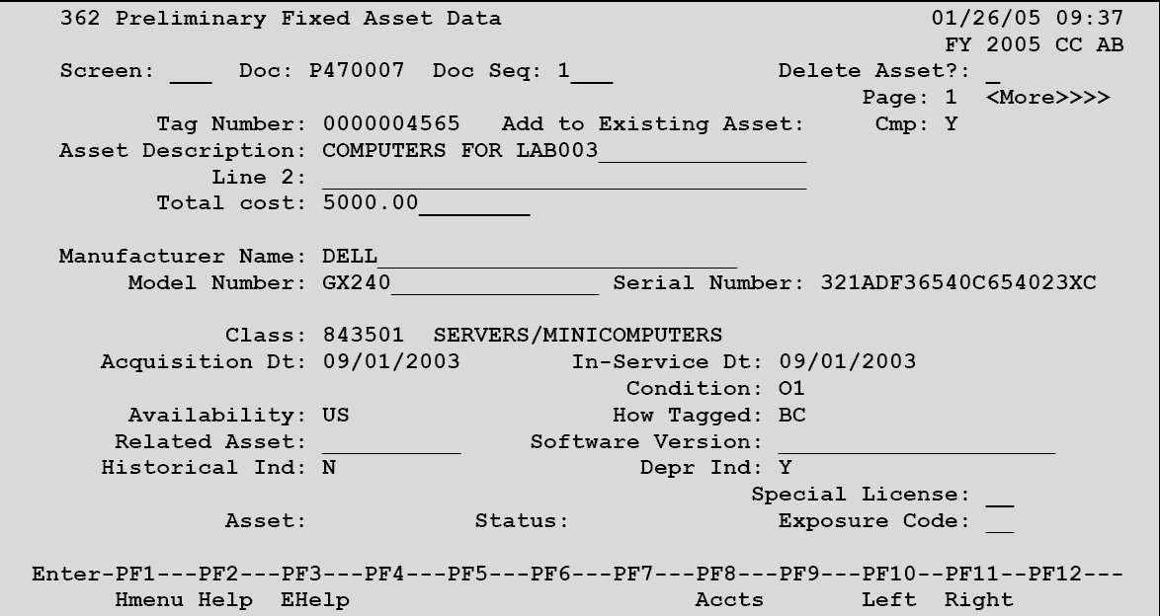
Screen 362 – Preliminary Fixed Asset Data Page #1
Notes:
Type PO number and Seq number from Screen 361; press enter; verify or enter all information—description, cost, manufacturer, model, serial number, class code, acquisition date, etc.; press enter. Press PF11 to advance to page 2.

Slide 25
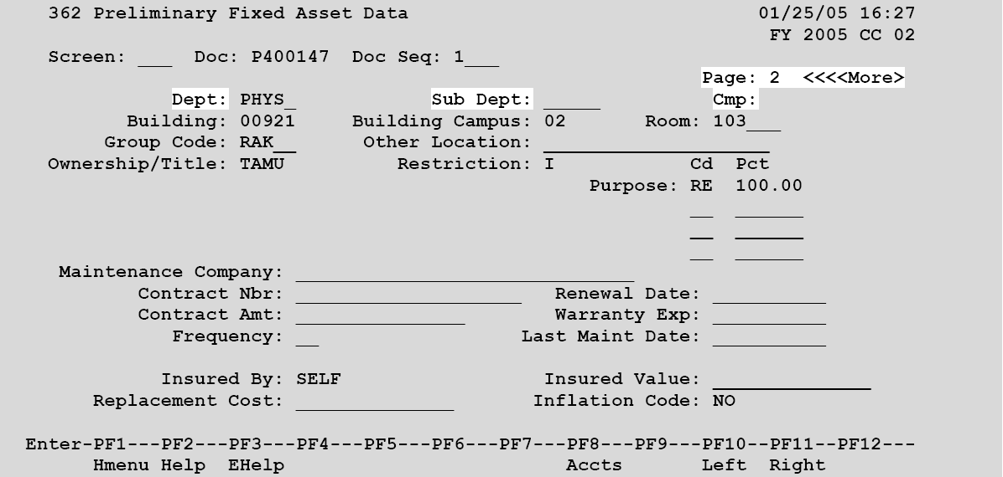
Screen 362 – Preliminary Fixed Asset Data Page #2
Notes:
Verify department; type building and campus code; add room number and other location (place or person); enter. Asset will now show completed status. Use a permanent marker to write the asset number on a blank label and affix it to the item.

Slide 26
NON-PURCHASING
PRELIMINARY ASSETS

Slide 27
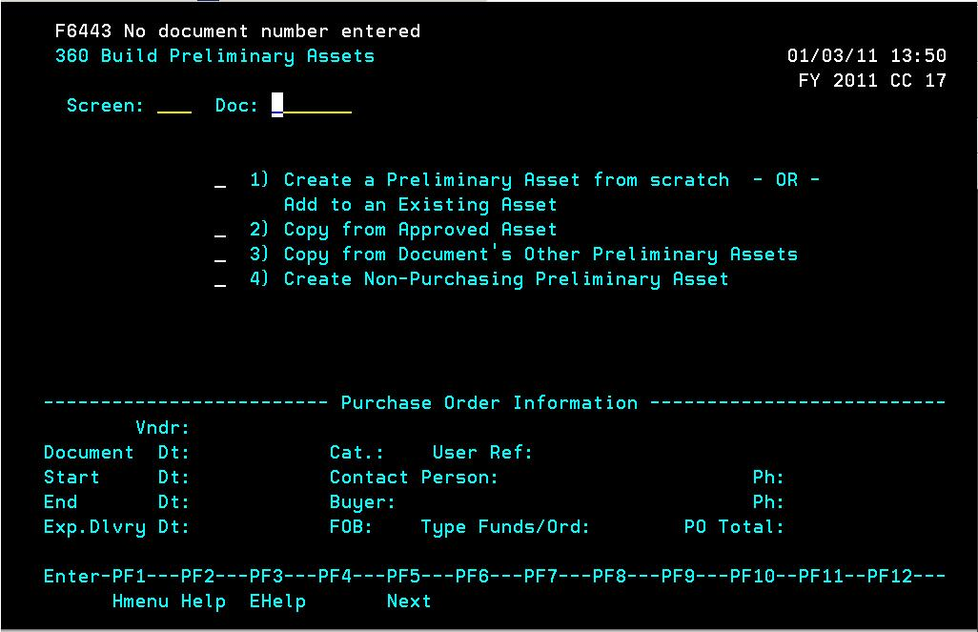
Screen 360 – Build Preliminary Assets
Create Non-Purchasing Preliminary Asset
Notes:
Select option 4

Slide 28
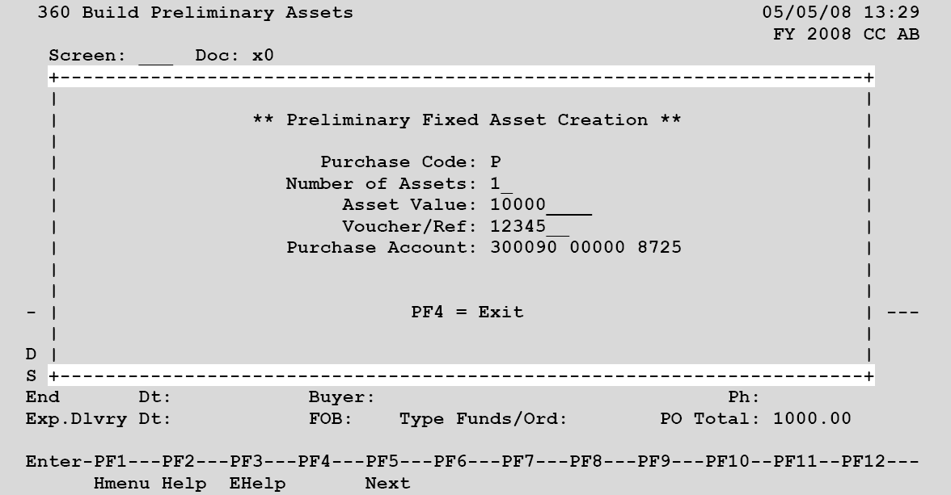
Screen 360 – Create Non-Purchasing Preliminary Asset Pop-up Window
Notes:
In Doc field use X0 to create a new record; add information requested on screen; press enter; enter the data on Screens 361 and 362 as with POs

Slide 29
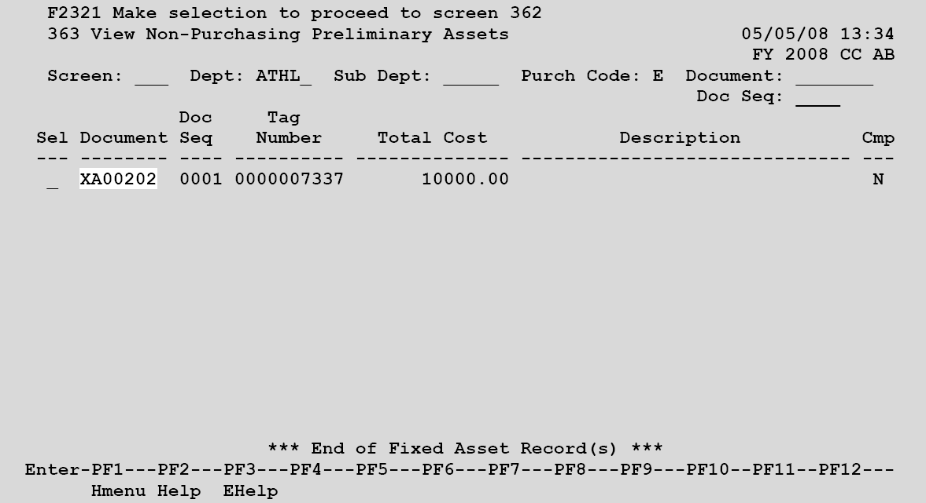
Screen 363- View Non-Purchasing Preliminary Assets

Slide 30
QUESTIONS

