Slide 1
Account Management
Division of Financial Services

Slide 2
Agenda Overview
Canopy Reports and Tips
Reading account screens and columns
Chart of Accounts
DBR Training
Creating a PCT

Slide 3
Canopy Reports and Tips

Slide 4
First, Log into Canopy
https://sso.tamus.edu

Slide 5
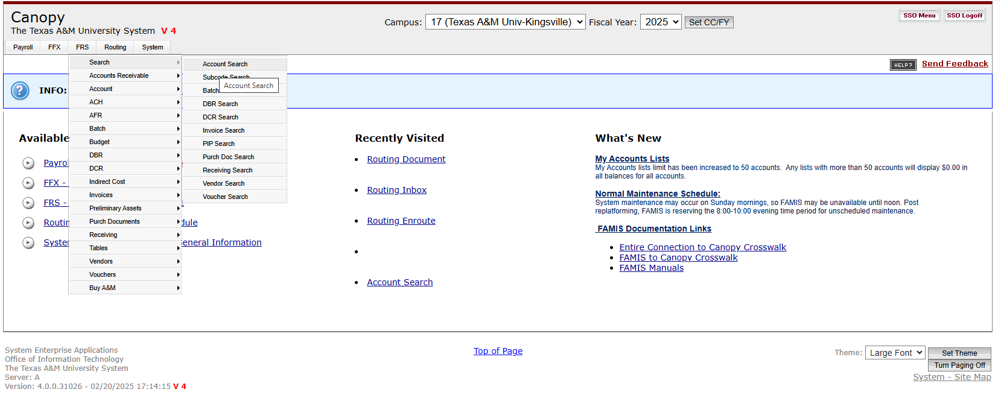
Without clicking, hold the cursor over the FRS tab.
A drop box will appear. Move the cursor over Search to Account Search, then click.

Slide 6
A new screen will open.
There will be an option to select an account from the dropdown menu or manually type in the account number.

Slide 7
Another feature is Show Support Accounts.
Select Yes, then click the Search box.

Slide 8
When the new screen opens, click the checkbox below the Add button. This will select all the accounts found in the search results, then click Add to continue.
If you prefer to select specific accounts, check the boxes next to each account you need, and then click Add.

Slide 9
Next, click the Reports tab. This will show the accounts selected in the search. From there, click the checkbox below All to select all the accounts, or select the accounts individually.

Slide 10
There are two icons above All: one for Excel and the other for PDF. Click on the preferred file type.

Slide 11
PDF Version of the Report

Slide 12
Excel Version of the Report

Slide 13
Monthly Account Summary

Slide 14
What Do These Numbers Mean?

Slide 15
Fund Sources

Slide 16
Budget Monitoring & Transfers
Monitoring
Which pools can I transfer from?
Continually check revenues/expenditures against budget
- Short on Revenue?
- Overspending?
-Unanticipated Expense?
Make proper budget adjustments to reflect actuals
-

Slide 17
Department Budget Request Training
(DBR)

Slide 18
What is a DBR?
Budget and fund transfers initiated at the departmental level are electronically routed for approval.
Created in Canopy under the FRS tab.
Embedded rules apply existing organizational limitations when creating transfers.

Slide 19
What are the Benefits?
• Departmental data entry
• Departmental electronic approvals
• Automatic posting upon approval
• FYI notification to recipients (destination)
• Security and account access controls
• Creation, routing, and approval through Canopy

Slide 20
When to use a DBR?
Primary Focus:
Type 1 (EP): Transfer funds between expense pools
Secondary Focus:
Type 2 (IB): Transfer funds between different accounts with same fund source
Type 3 (PR): Transfer funds for costing allocation encumbrance involving Payroll

Slide 21
Transaction NOT Allowed
• Funds cannot be transferred between accounts that have different funding source.
• Correcting operational or payroll expenses
• Transfers from Reserves
• Project account transfers

Slide 22
DBR Cycle
Creation is made at the department level
Supporting documentation must be attached to the DBR (account balance screenshot, emails, etc.)
Routing and approval go through the departmental path
Completion of document will process within FAMIS/CANOPY
Notifications will be sent to creator and any FYI recipients as noted

Slide 23
DBR Menu Selection

Slide 24
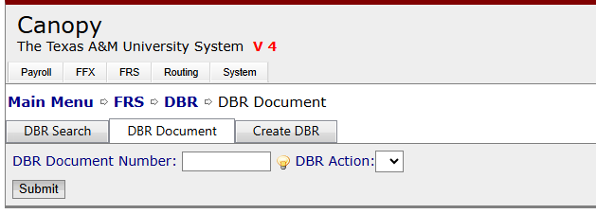
DBR Search

Slide 25
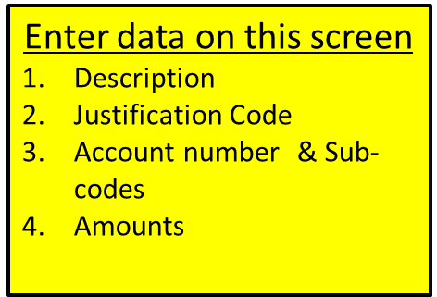
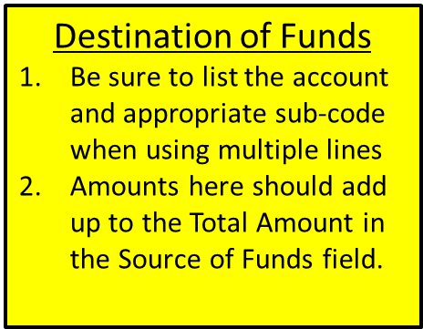
DBR Entry Screen

Slide 26
DBR Document
The DBR is now created, but there are still more steps that need to be completed.
It is required to Add Attachments

Slide 27
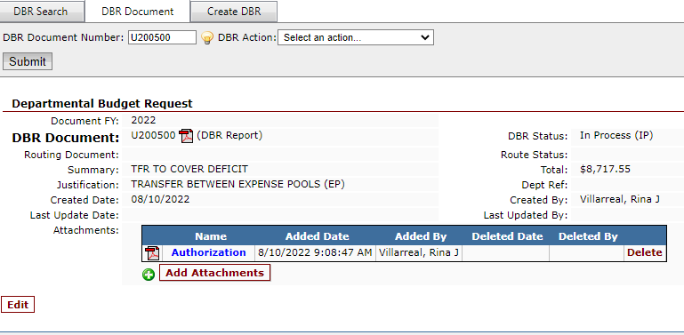
How to Add Justification and/or Authorization
DON’T FORGET TO CLICK “ADD ATTACHMENT”!

Slide 28
Route for Approval
This is the last step to route a DBR.
Once attachment(s) have been added, you may:
Click “Route for approval” and
Click “Submit”

Slide 29
DBR Field Relationships
• Summary
Reason for the transfer, not the mechanics
Specific and meaningful
• Justification Code
Transaction type
• Notes
Additional space for specific reasons, names, reference numbers, or circumstances which may not fit in the Summary field

Slide 30
Justification Codes

Slide 31
Budget Transfer
• Account management
• DBR - Once costing allocation business process is complete
• Vacant Position - Respective Salary Savings
• New Position - Identify source and funds
• Adjunct - Utilize adjunct accounts (New Processes coming!)

Slide 32
Budget Transfer Verification
• Check your accounts!
• Verify encumbrance
• Is the budget correct?
• Is the costing allocation correct?
– Verify Worker Position level
• Student wages – Simple transfer

Slide 33
Rejected DBRs
• Anyone along the routing path may reject a DBR for revision.
• DBRs return to the creator
• Steps for revision:
Reopen (Canopy FRS/DBR/Document), correct, and close/reroute.
Add additional notes to Document Notes

Slide 34
Recommendations
• Do not use the word “Transfer” as the sole Summary/Description.
• Make the Summary explicit and specific.
• Add revision notes to the DBR / Document notes instead of the routing notes.
• Don’t assume anything is obvious.
• In Canopy, remember to “Submit” actions and Save edits

Slide 35
PAYROLL COST TRANSFER
(PCT)

Slide 36
Creating and Submitting a PCT

Slide 37
Accessing Payroll Cost Transfer Worksheet
Select Payroll Tab
Select Payroll Cost Transfer
Select PCT Worksheet

Slide 38
Entering UIN or Name
You can search by UIN or Employee Name

Slide 39
Select Pay Period End Date
Choose the UIN/employee name and click search
Choose the Fiscal Year for the payroll
Choose the actual Pay Period End Date you wish to affect

Slide 40
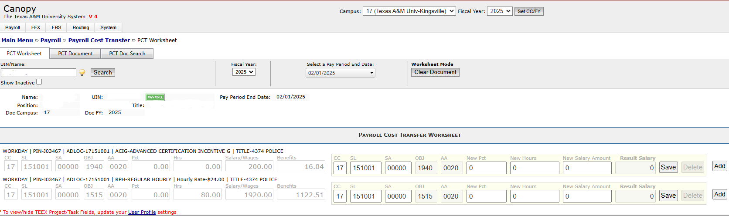
Worksheet Info
When you select the Pay Period End Date, the posted payroll will appear in a PCT worksheet for edits
The Pay Period End Date drop down is controlled by existing posted records for the emoloyee
Original Summary Record will be grayed out
Below the Original Summary Record, a line is presented allowing entry of data into certain fields
Account
Object code
Percentage or Dollar Values

Slide 41
Making Corrections

Slide 42
Hourly Corrections
Hourly corrections must be entered using number of hours to be corrected under New Hours column.

Slide 43
Salary Corrections
Salary Amount corrections must be entered with a flat dollar amount not a percentage. Canopy will not calculate a percentage.

Slide 44
Create FY Document
When all necessary corrections are entered, you can now create your document.

Slide 45
PCT Document Entry
Enter Description
Choose a Justificaton Code (Some codes require additional notes)
Add attachments
CLICK SAVE

Slide 46
PCT Document Entry
Add Notes and FYI Recipients
Click Update Cost Transfer if needed to return to the Worksheet
CLICK SAVE

Slide 47
Submit for Routing
Click on the Action drop down
Select Route for Approval
Click Submit
Once submitted into Routing and Approval, the Route document will be populated

Slide 48
PCT Document Search
Search by Document ID, Campus Code or UIN/Name
Filter by Status or Fiscal Year

